Slide 1

SMÆKKYS®偲美可思
Brand Introduction

Slide 2

Our Story
品牌故事
Our Name
名字起源
Our Design
产品介绍
Contents
Our Designer
主设计师
The School Of Design
丹麦皇家艺术学院

Slide 3

OUR STORY
High up north you find the vast landscape of the Nordic countries. Everything is blanketed in a cover of white snow that seem to mute all noise. The air is crisp, fresh and cool.
Inspired by this beautiful scenery, SMÆKKYS® has set out to create a jewelry brand which is as pure, clean and breathtakingly beautiful as Scandinavia itself.
We call it the new Nordic look.
Brand Story
品牌故事

Slide 4

OUR NAME
Kissing is an important cultural norm in Scandinavia and a way to display love and affection for your friends and family.
These kisses are often delivered as something they in Denmark call a “smækkys” [ˈsmεgˌkøs]; a kiss made with a sound.
That is why we have named our company SMÆKKYS®.
As a jewelry brand based on the Nordic way of life, we want to invite you into our family in the way the people of Scandinavia knows best, namely with a big smack kiss.
Because as we all know, every great relationship starts with a kiss.
Brand Story
品牌故事

Slide 5
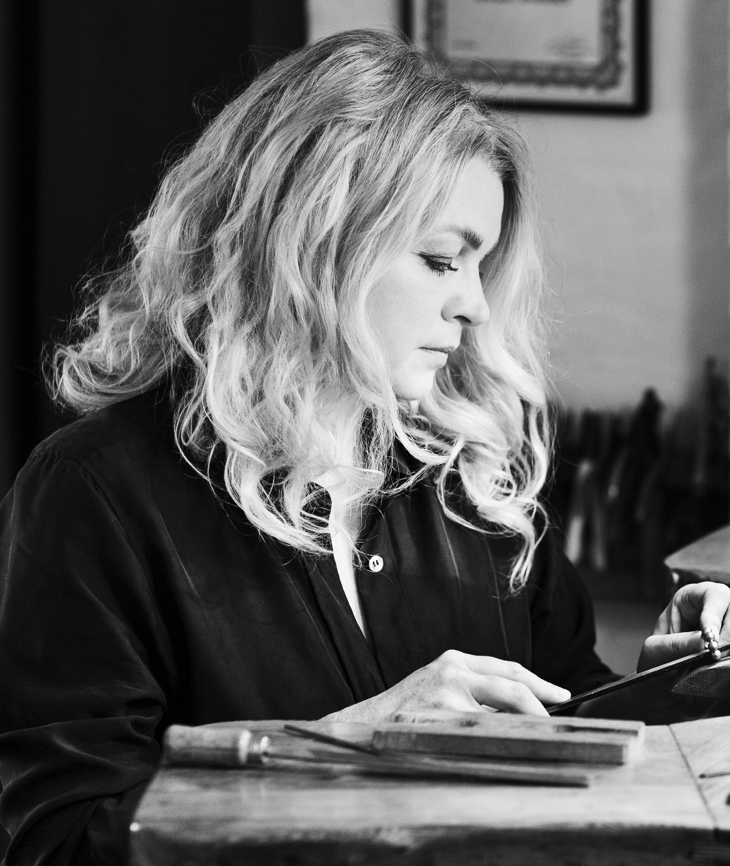
OUR DESIGN
Our chief designer is the Danish fine jewelry designer, Bodil Binner. Renowned for dressing international film stars and royalty with magnificent jewelry creations, when they attend red carpet events and gala banquets around the world.
Her creativity is rooted in Nordic minimalism. But the main source of inspiration she finds in the cool, clean, snow covered landscape of the Nordic countries.
From the serenity of nature, she collects impressions, which she later transforms into truly exclusive jewelry pieces.
Come experience the beauty of SMÆKKYS® for yourself today.
Brand Story
品牌故事

Slide 6
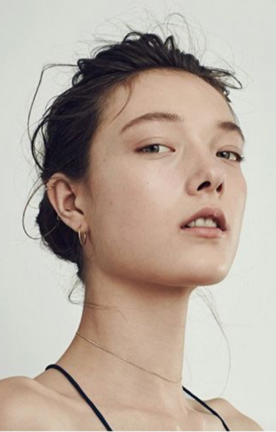
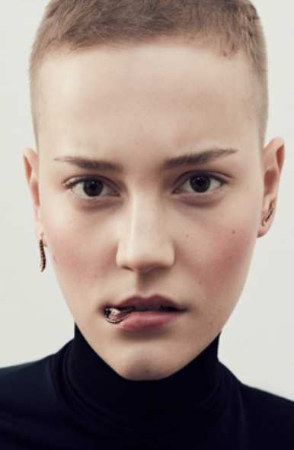

Consumer
年轻
独立
简洁
都市女性
Feminine
Cool
Casual

Slide 7
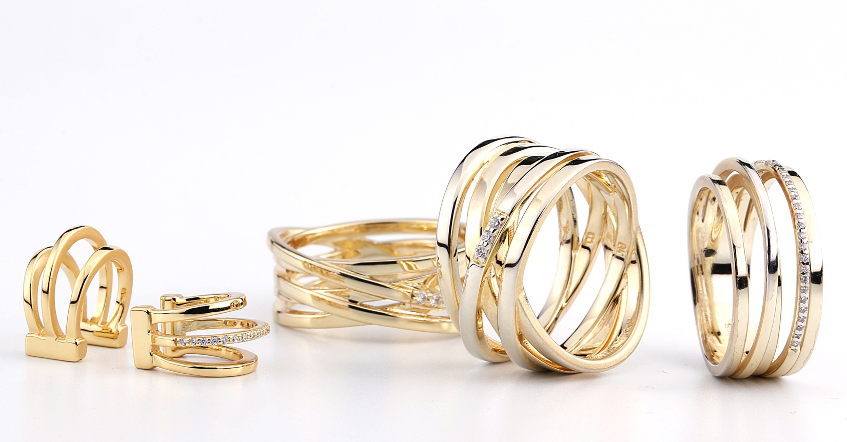
Product
核心产品
Bodil Binner

Slide 8
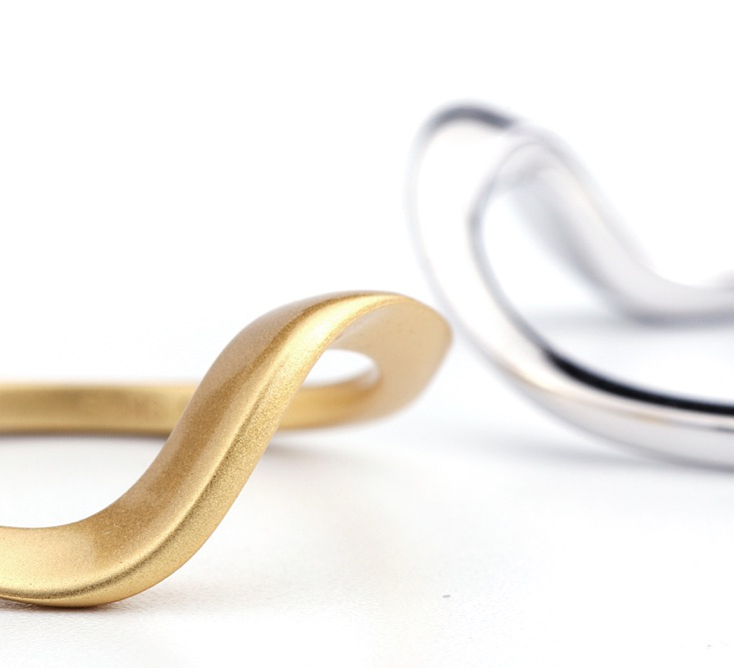
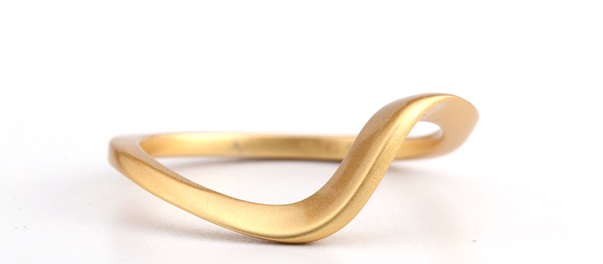
Product
核心产品
Bodil Binner

Slide 9
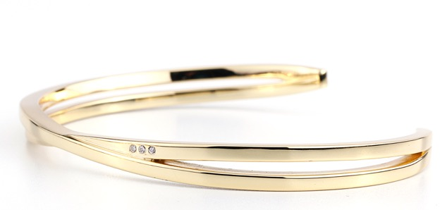
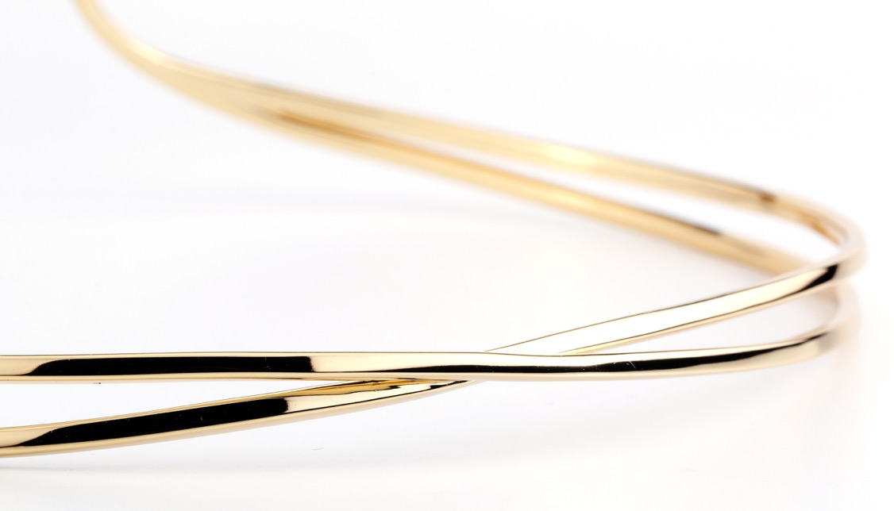
Product
核心产品
Bodil Binner

Slide 10
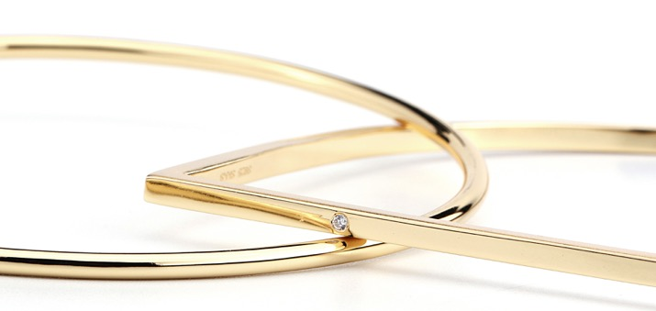
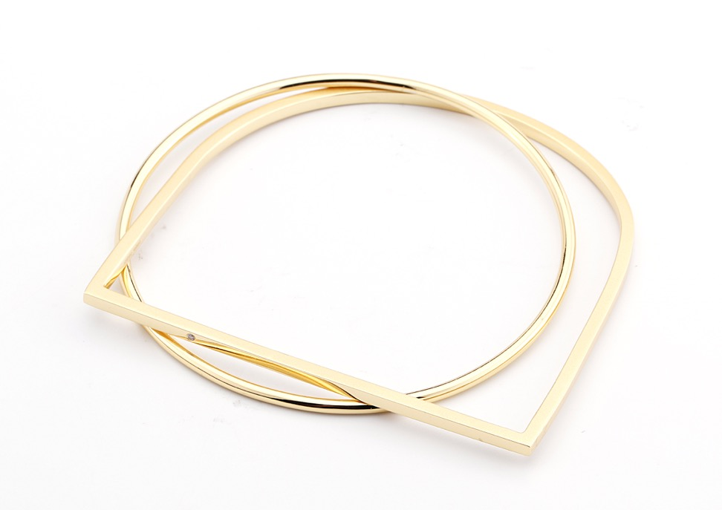
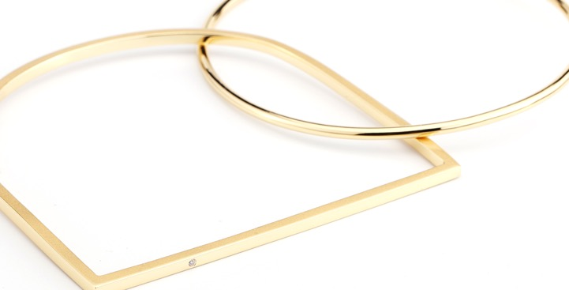
Product
核心产品
Bodil Binner

Slide 11
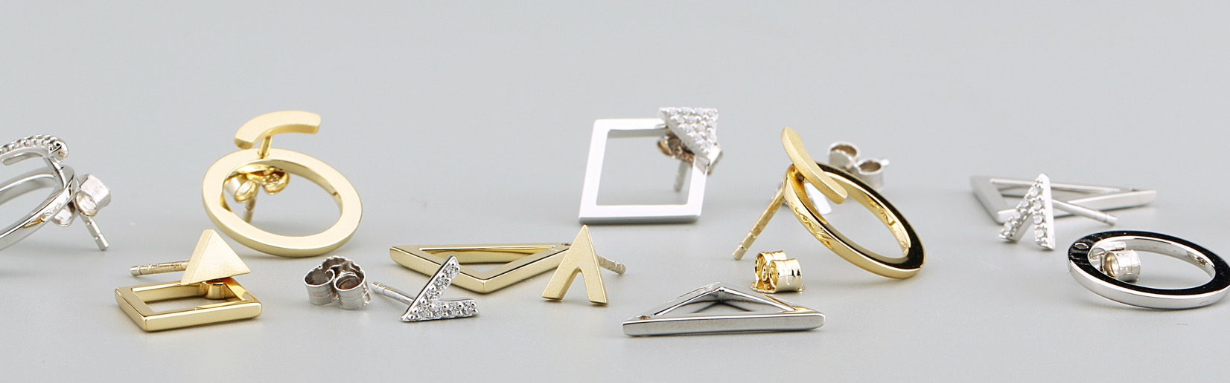
Product
几何元素
For work

Slide 12
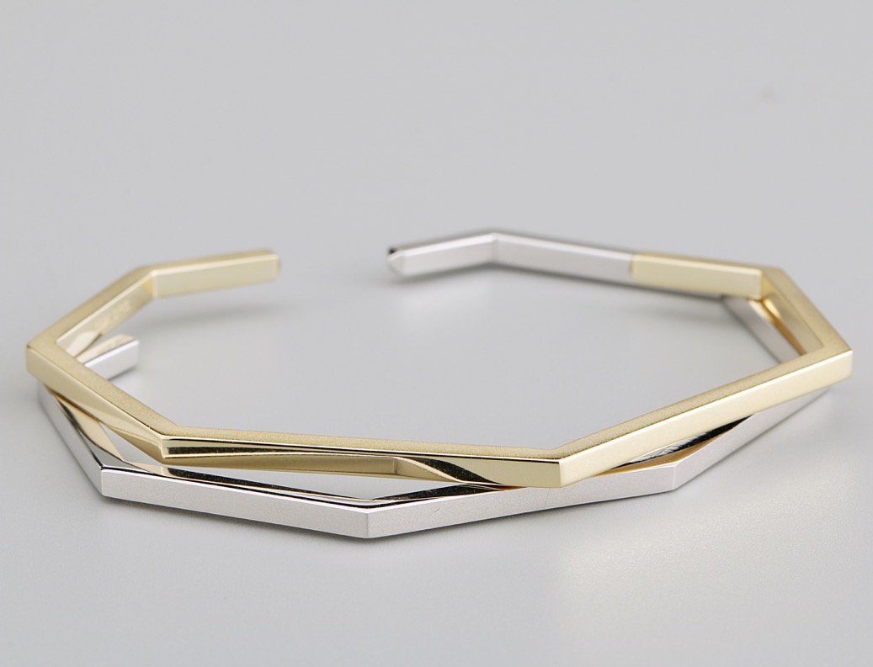
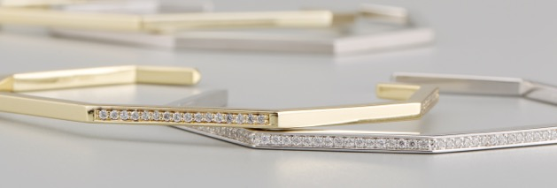
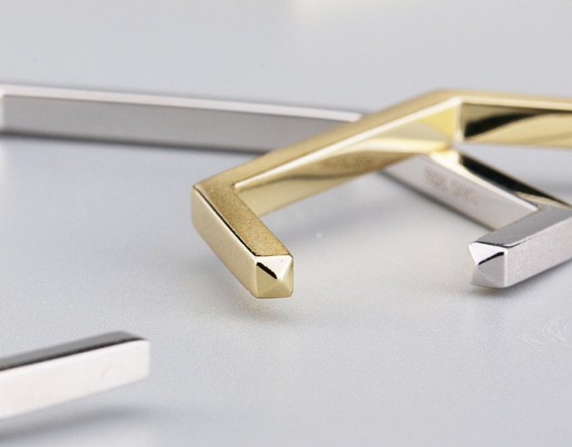
Product
几何元素
For work

Slide 13
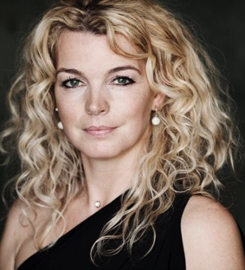
Introducing our core designer, Bodil Binner
150 Years Celebrating Japan – Denmark
The Annual Showcase of Crafts Guilds
Strength & Beauty – Royal Danish Ballet jewelry. Co-promoter and exhibitor of jewelry from the Royal Danish Ballet displayed at the Royal Danish Theater in Copenhagen
Pearls – Royal splendor, modern design. Co-promoter and exhibitor of pearls at Rosenborg Castle
Tiara – Co-promoter and exhibitor of tiaras at Amalienborg Royal Museum
Food for thoughts. Sustainable fashion at Koldinghus museum
NOTCH – Danish Cultural Institute in Beijing.
Fair Trade Jewelers, Kunstindustrimuseet/Design Museum Denmark in Copenhagen
Exhibition at Galleri Hoff in Copenhagen
Exhibition in Reykjavik, Icelannd with PIECES, The Gallerie
ARTSPACE 2005, Henley-on-Thames, United Kingdom
ARTSPACE 2004, Henley-on-Thames, United Kingdom
Exhibition at Hawker Gallery, Old Amersham, United Kingdom
Exhibition at Gallery Bagger & Gehring Goldschmiede, Hamburg
Exhibitions at Institute for Precious Metals at Kunstindustrimuseet and the Danish Design Museum, Copenhagen
Exhibition at Gallerie Hoss, Göteborg

Slide 14
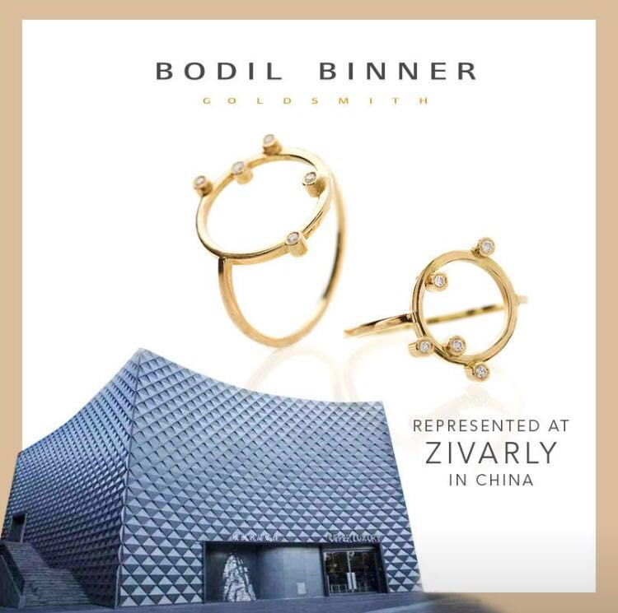
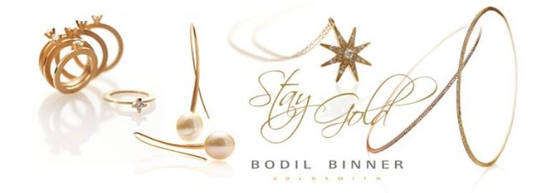
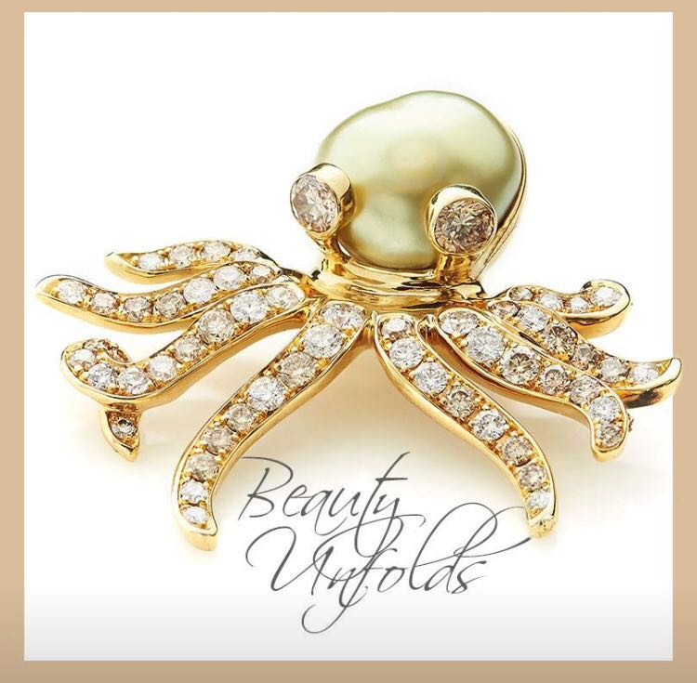
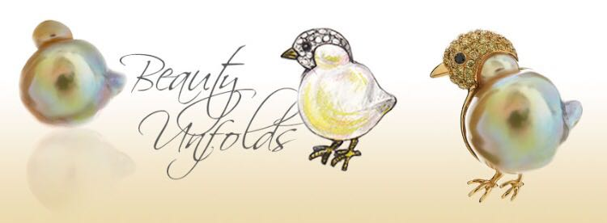
Introducing our core designer, Bodil Binner

Slide 15

The Royal Danish Academy of Fine Arts-The School of Design
与北欧250年历史，最古老的艺术设计学院-丹麦皇家艺术学院达成长期合作，为我们源源不断地输送新北欧设计理念的艺术作品及生活方式，传递北欧人与人平等、人与自然和谐相处，资源及环境可持续开发及使用的理念和价值观。

